Slide 1
00882 - ALGORITHMS Introduction
Md. Faruk Abdullah Al Sohan
Lecturer
, Department of Computer Science
American International University-Bangladesh (AIUB)
faruk.sohan@aiub.edu
Room: DN0127C

Slide 2
Lecture Outline
Vision, Mission, Goal, Objective
Definitions
Computational Problems, Analysis, Design, and importance of Algorithms
Space & Time Complexity as parameters of performance for Algorithms including Asymptotic notations and
Preliminary data structure review

Slide 3
Vision & Mission of AIUB
Vision
AMERICAN INTERNATIONAL UNIVERSITY-BANGLADESH (AIUB) envisions promoting professionals and excellent leadership catering to the technological progress and development needs of the country.
Mission
AMERICAN INTERNATIONAL UNIVERSITY-BANGLADESH (AIUB) is committed to provide quality and excellent computer-based academic programs responsive to the emerging challenges of the time. It is dedicated to nurture and produce competent world class professional imbued with strong sense of ethical values ready to face the competitive world of arts, business, science, social science and technology.

Slide 4
Goals of AIUB
Sustain development and progress of the university
Continue to upgrade educational services and facilities responsive of the demands for change and needs of the society
Inculcate professional culture among management, faculty and personnel in the attainment of the institution's vision, mission and goals
Enhance research consciousness in discovering new dimensions for curriculum development and enrichment
Implement meaningful and relevant community outreach programs reflective of the available resources and expertise of the university
Establish strong networking of programs, sharing of resources and expertise with local and international educational institutions and organizations
Accelerate the participation of alumni, students and professionals in the implementation of educational programs and development of projects designed to expand and improve global academic standards

Slide 5
Vision & Mission of Computer Science Department
Vision
Provides leadership in the pursuit of quality and excellent computer education and produce highly skilled and globally competitive IT professionals.
Mission
Committed to educate students to think analytically and communicate effectively; train them to acquire technological, industry and research-oriented accepted skills; keep them abreast of the new trends and progress in the world of information communication technology; and inculcate in them the value of professional ethics.

Slide 6
Goals of Computer Science Department
Enrich the computer education curriculum to suit the needs of the industry- wide standards for both domestic and international markets
Equip the faculty and staff with professional, modern technological and research skills
Upgrade continuously computer hardware's, facilities and instructional materials to cope with the challenges of the information technology age
Initiate and conduct relevant research, software development and outreach services.
Establish linkage with industry and other IT-based organizations/institutions for sharing of resources and expertise, and better job opportunities for students

Slide 7
Course Objectives
The objective of this course is to teach how we can compare algorithms, the complexity analysis of time and space, effective data structure for solving difficult problems and implementation of different algorithms with the practical examples.
The purpose of the course is
a) to raise your level of sophistication in thinking about the design and analysis of algorithms;
b) learn some of the classic algorithms and recent improvements;
c) exercise your creativity in designing algorithms.

Slide 8
Course Prerequisites
Programming
Data types, operations
Conditional statements
Loops
Procedures and functions
C/ C++/ Java
Discrete Mathematics (proof theorems)
Data Structures (array, structure, pointer, file, etc...)
Computer lab (edit, compile, execute, debug)
If you lack of any of the above please refine yourselves.

Slide 9
Importance of the course
This course is a continuation of the courses Programming Language 1 & 2, and Data Structure.
Algorithm is required for all areas of computer science – especially for developing problem solving ability.
This course will give the basic for the understanding of the courses –Theory of Computation, Artificial Intelligence, etc.
This course will give the basic for the understanding of the concepts – Design and Analysis of Algorithm.

Slide 10
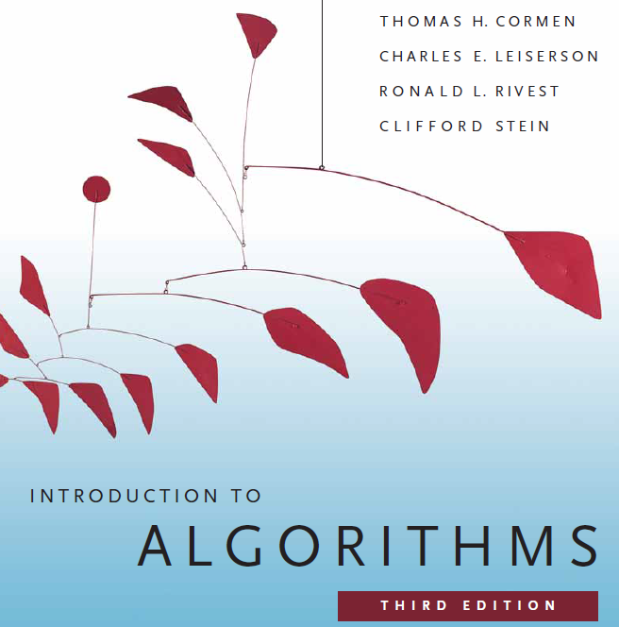

Slide 11
The Goals of this Course
To think algorithmically
To understand and learn the idea behind algorithm design techniques
To get to know a toolbox of classical algorithms.
To reason (in a precise and formal way) about the efficiency and the correctness of algorithms.

Slide 12
What is Algorithm?

Slide 13
Informally
takes some value or set of values as input
produces some value or set of values, as output
Algorithm: any well-defined computational procedure
An algorithm is thus a sequence of computational steps that transform the input into the output.
Solving a given problem:
Data structure: Organization of data to solve the problem at hand.
Algorithm: Outline, the essence of a computational procedure, step-by-step instructions.
Program: Implementation of an algorithm in some programming language.

Slide 14
Algorithmic problem
Specification of output as a function of input
Specification of input
Algorithm
Input: sequence ⟨a₁, a₂, …, a_{n}⟩ of numbers.
Output: permutation ⟨a'₁, a'₂, …, a'_{n}⟩ such that a'₁ ≤ a'₂ ≤ … ≤ a'_{n} .
The problem of sorting
Example:
Input: 8 2 4 9 3 6
Output: 2 3 4 6 8 9

Slide 15
Algorithmic Solution
Input instance, adhering to the specification
Output related to the input as required
Algorithm
Algorithm describes actions on the input instance.
There may be many correct algorithms for the same algorithmic problem.
Introduction→15

Slide 16
Definition of an Algorithm
An algorithm is a sequence of unambiguous instructions for solving a problem, i.e., for obtaining a required output for any legitimate input in a finite amount of time.
Properties:
Precision
Determinism
Finiteness
Efficiency
Correctness
Generality

Slide 17
Sorting
Sorting is a classical and important algorithmic problem.
We look at sorting arrays (in contrast to files, which restrict random access).
A key constraint is the efficient management of the space
In-place sorting algorithms
The efficiency comparison is based on the number of comparisons (C) and the number of movements (M).

Slide 18
Sorting
Simple sorting methods use roughly n * n comparisons
Insertion sort
Selection sort
Bubble sort
Fast sorting methods use roughly n * log n comparisons.
Merge sort
Heap sort
Quicksort

Slide 19
Insertion Sort
while some elements unsorted:
Using linear search, find the location in the sorted portion where the 1st element of the unsorted portion should be inserted
Move all the elements after the insertion location up one position to make space for the new element

Slide 20
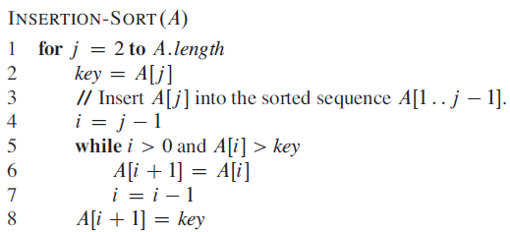
Insertion Sort Simulation
j
j
j
j
j
j
j
j
j
i
i
i
i
i
i
i
i
i
i
66
22
99
77
11
91
55
88
44
Key
22
11
33
66
33
22
66
33
22
77
66
55
44
99
77
99
77
66
55
99
91
77
66
11
99
91
88
77
91
55
99
91
88
88
99
91
44
99
0
1
2
3
4
5
6
7
8
9

Slide 21
References & Readings
CLRS
Chapters: 1, 2 (2.1, 2.2), 3
Exercises: 1.2-2, 1.2-3, 2.1-3, 2.1-4, 2.2-1, 2.2-3, 3.1-1, 3.1-4, 3.1-6, 3.1
Problems: 1-1, 3-3
HSR
Chapters: 1 (1.1-1.3)
Examples: 1.4-1.6, 1.11-1.13, 1.17-1.18
Exercises: 1.3 (1-4, 8, 9)
Review for laboratory
HSR
Chapters: 2, 3.2 - 3.5
CLRS
Chapters: 6, 7, 10, 12

